Slide 1
Spotify and youtube
This is an EDA and ML project using a quiet interesting data, and in this representation I’ll talk about all the challenges that faced me and all what I’ve gone through in the process of making this project

Slide 2
About the data
Dataset of songs of various artist in the world and for each song is present:
Several statistics of the music version on Spotify, including the number of streams;
Number of views of the official music video of the song on YouTube.

Slide 3
Content
It includes 26 variables for each of the songs collected from spotify. These variables are briefly described next:
Track: name of the song, as visible on the Spotify platform.
Artist: name of the artist.
Url_spotify: the Url of the song.
Album: the album in wich the song is contained on Spotify.
Album_type: indicates if the song is relesead on Spotify as a single or contained in an album.
Uri: a spotify link used to find the song through the API.
Danceability: describes how suitable a track is for dancing based on a combination of musical elements including tempo, rhythm stability, beat strength, and overall regularity. A value of 0.0 is least danceable and 1.0 is most danceable.
Energy: is a measure from 0.0 to 1.0 and represents a perceptual measure of intensity and activity. Typically, energetic tracks feel fast, loud, and noisy. For example, death metal has high energy, while a Bach prelude scores low on the scale. Perceptual features contributing to this attribute include dynamic range, perceived loudness, timbre, onset rate, and general entropy.
Key: the key the track is in. Integers map to pitches using standard Pitch Class notation. E.g. 0 = C, 1 = C♯/D♭, 2 = D, and so on. If no key was detected, the value is -1.
Loudness: the overall loudness of a track in decibels (dB). Loudness values are averaged across the entire track and are useful for comparing relative loudness of tracks. Loudness is the quality of a sound that is the primary psychological correlate of physical strength (amplitude). Values typically range between -60 and 0 db.

Slide 4
Speechiness: detects the presence of spoken words in a track. The more exclusively speech-like the recording (e.g. talk show, audio book, poetry), the closer to 1.0 the attribute value. Values above 0.66 describe tracks that are probably made entirely of spoken words. Values between 0.33 and 0.66 describe tracks that may contain both music and speech, either in sections or layered, including such cases as rap music. Values below 0.33 most likely represent music and other non-speech-like tracks.
Acousticness: a confidence measure from 0.0 to 1.0 of whether the track is acoustic. 1.0 represents high confidence the track is acoustic.
Instrumentalness: predicts whether a track contains no vocals. "Ooh" and "aah" sounds are treated as instrumental in this context. Rap or spoken word tracks are clearly "vocal". The closer the instrumentalness value is to 1.0, the greater likelihood the track contains no vocal content. Values above 0.5 are intended to represent instrumental tracks, but confidence is higher as the value approaches 1.0.
Liveness: detects the presence of an audience in the recording. Higher liveness values represent an increased probability that the track was performed live. A value above 0.8 provides strong likelihood that the track is live.
Valence: a measure from 0.0 to 1.0 describing the musical positiveness conveyed by a track. Tracks with high valence sound more positive (e.g. happy, cheerful, euphoric), while tracks with low valence sound more negative (e.g. sad, depressed, angry).
Tempo: the overall estimated tempo of a track in beats per minute (BPM). In musical terminology, tempo is the speed or pace of a given piece and derives directly from the average beat duration.
Duration_ms: the duration of the track in milliseconds.

Slide 5
Stream: number of streams of the song on Spotify.
Url_youtube: url of the video linked to the song on Youtube, if it have any.
Title: title of the videoclip on youtube.
Channel: name of the channel that have published the video.
Views: number of views.
Likes: number of likes.
Comments: number of comments.
Description: description of the video on Youtube.
Licensed: Indicates whether the video represents licensed content, which means that the content was uploaded to a channel linked to a YouTube content partner and then claimed by that partner.
official_video: boolean value that indicates if the video found is the official video of the song.

Slide 6
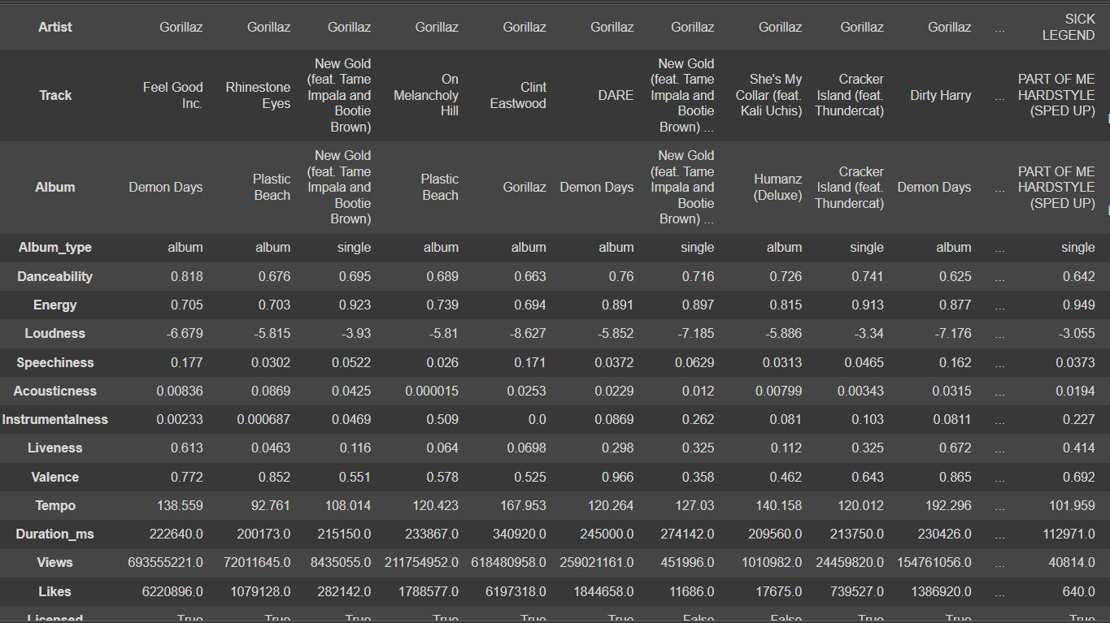

Slide 7
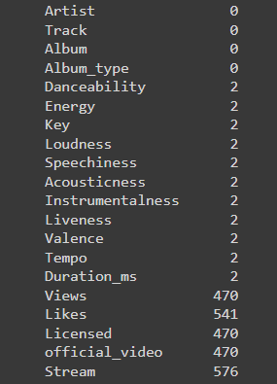
So first I removed some of the columns that won’t be of any use for us
And then checked for nulls, so as we go along my goal was to fill these null using machine learning models to get the best values for them
There were these two rows that bugged me for having null values as you can see in the picture so I dropped them

Slide 8
Data analysis
But before we go on with the machine learning models we first must do some analysis on the data

Slide 9
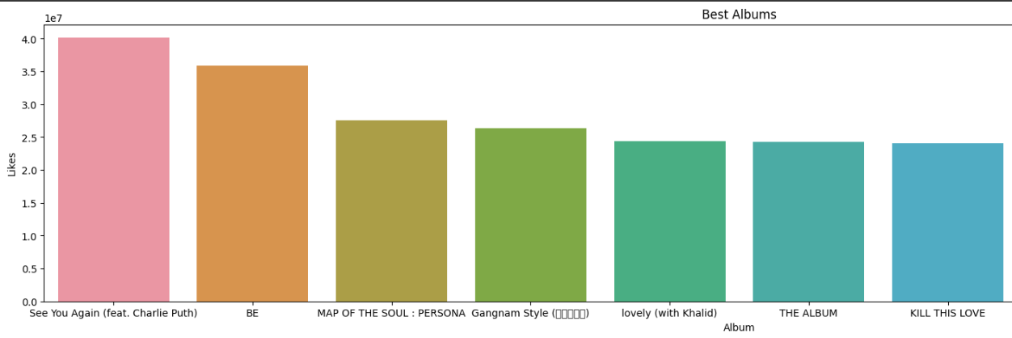
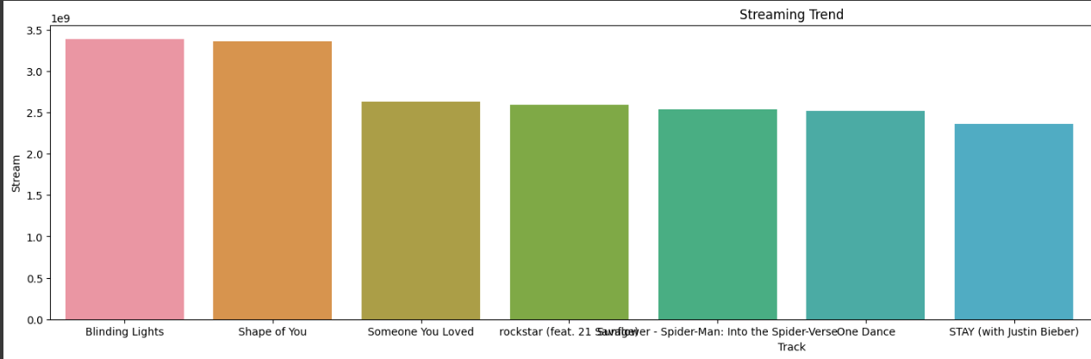
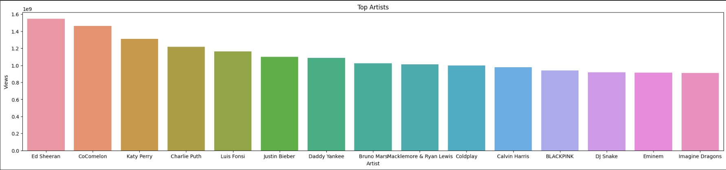
After these analysis I started to reconsider my taste in music
Sorry if that doesn’t seem pleasing but I wanted to put them all in one slide, I thought that would be a waste of slides if I’ve put every one of them in a slide

Slide 10
There are also many other data analysis and visualization I used to find common stuff and patterns in the data but they are too many to fit in the representation so instead I will put a gif ☺

Slide 11
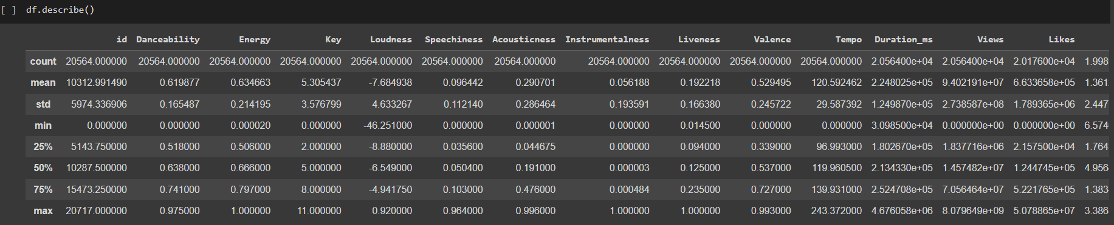
Reaching for views
So while analyzing the data I was trying to get any relation or any pattern between two or more columns so that I could get or predict the null values(using Regression) but couldn't find any so I'll try to find another approach.
so in my mind I would try to make new list called trend for example.
since that I can't quiet predict how many views or likes or streams (logically it's something that can't be predicted) so what we can do is find out whether the song is (or could be) trendy or not using the artist and the album it's in. we find a song trendy if singer is popular or it is in a popular album, and by popular I mean that how many views are there in his other tracks
I am gonna leave this table right here so we could compare it to future table when we modify the data
The two important columns here are the views and the likes

Slide 12
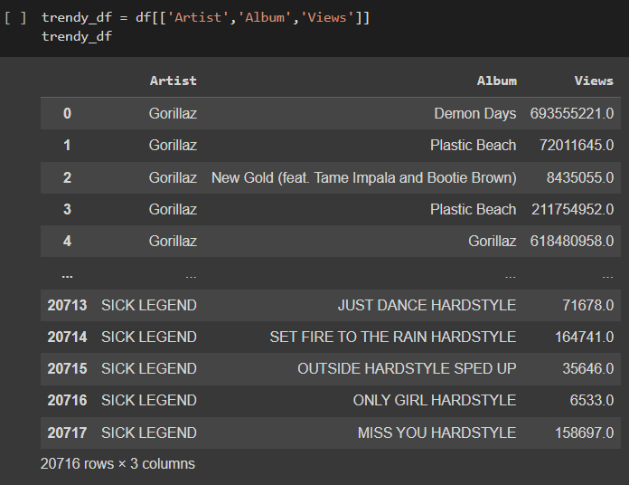
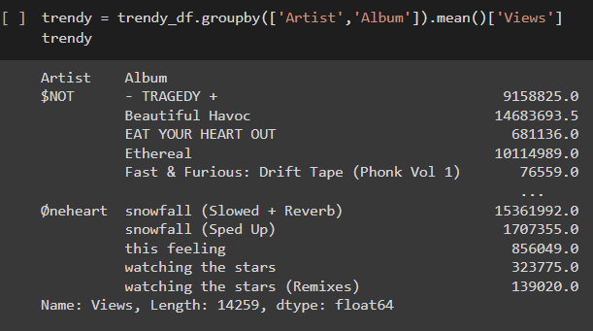
So I took the tables that would be of help in predicting the views, so if the artist is popular so that means people listen to him more and if an album is also popular so a song in this album would be heard more than other in an unpopular album, so I grouped by these two tables and using the mean with views this gave me an estimate of how much would a song would be viewed.

Slide 13
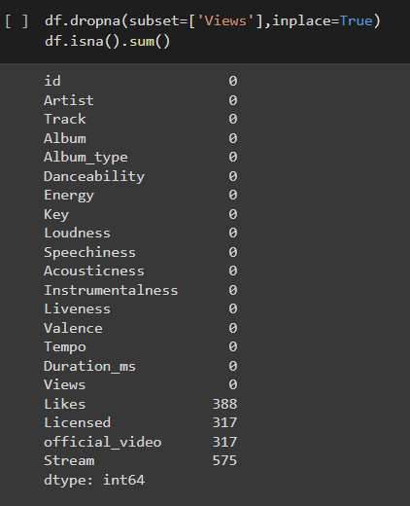
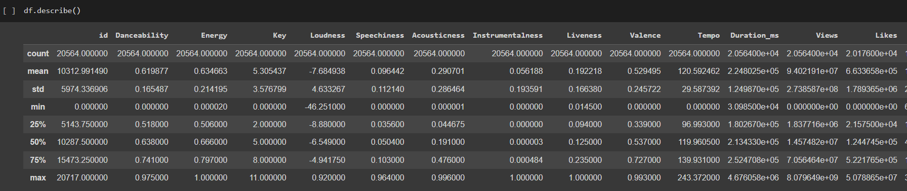
And so I updated the data with the table I made and it went really smooth, the nulls were reduced and the data didn’t change that much

Slide 14
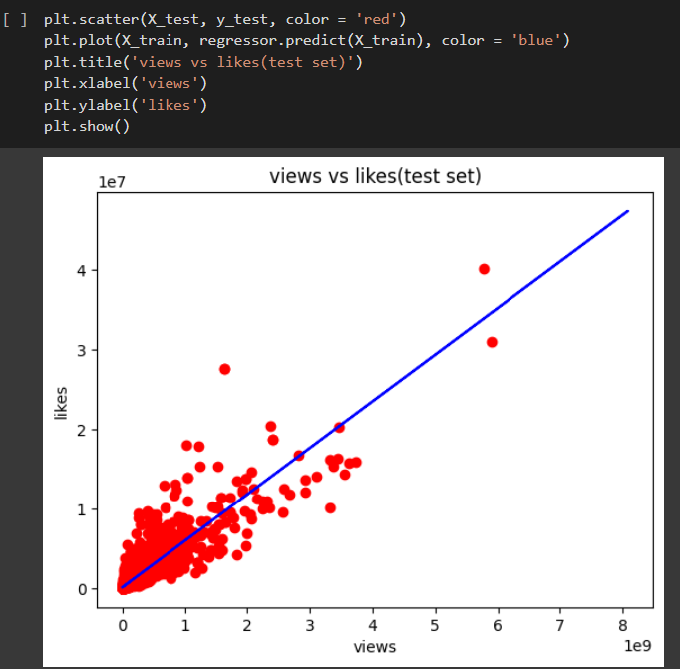
Linear regression
After a successful prediction of the views (or that’s what I like to call it) I used the views to get the likes, since the likes mostly depend on how many views are on the song, which gave a score of 79%, which I would also call a successful model

Slide 15
Multiple Linear Regression
So I uses multiple linear regression to make model that would predict the streams.
But unfortunately this part turned out to be not as successful as I thought it would be, I tried different columns with the data but the best score I reached was 39% score, so the Streams was not something to be predicted by song features. sadly I kept the nulls in the Stream column untouched 😞

Slide 16
Break time

Slide 17
Tree based models
So I used tree classification on the licensed and the official video columns, and I was actually impressed on how the tree classifier chose how a song is licensed or not, it used some interesting columns to predict whether the song is licensed or not which really made me fond of the Tree Based Models

Slide 18
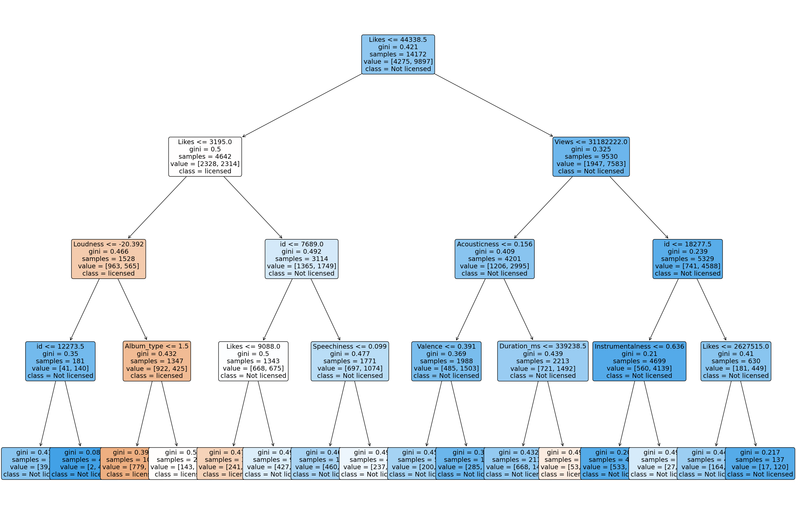

Slide 19
clustering
so since I had all these music data details, I thought I could have some fun and use these data to categorize my data.

Slide 20
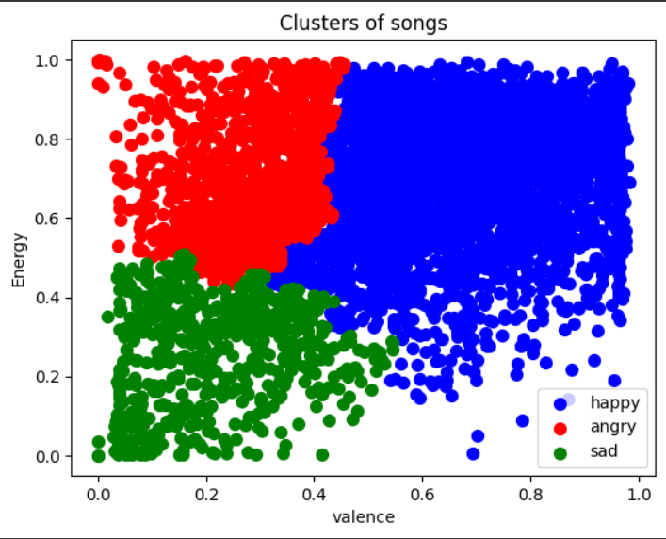
mood
so one way of categorizing the data by using valence and energy, like for example the song is either a happy song or sad song or an angry(or hatred) one
There is another one I made but it turned out really bad so I’m not gonna put it here

Slide 21
Thank you
Special thanks to Eng. Sohaila Diab and Eng. Mira Ehab for all their hard work, I truly appreciate all your work and the wonderful content that you made, thank you so much <3
and thanks to all the other instructors of the GDSC community.
Thanks to the audience if there is ☺(I’m not sure if this is gonna be represented or not so I’m gonna leave this here).

